Slide 1
Nearest Emergency Exit Locator (NEEL)
Exceptions Programming Team - FEU Tech
Blue Hacks 2018

Slide 2






Slide 3

Solution:
Nearest Emergency Exit Locator App
Notes:
From the project title itself, the app determines the nearest possible emergency exit from where the user is currently located. The supported beacon types ranges from iBeacons, Eddystone beacons, Bluetooth Low Energy beacons and many more. The application does not need data or an internet connection and only utilizes bluetooth technology, which is a great feature since there are plenty of factors that can disrupt internet connection and data signal to drop in situations of disaster.

Slide 4
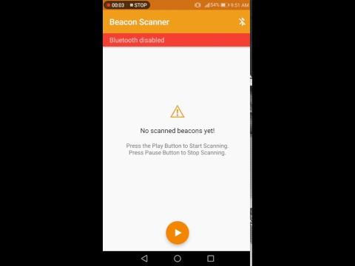
App Demo

